Slide 1


International Investment Law
2025/2026
Seminar 1
Introduction and historical development
Professor James Devaney
james.devaney@glasgow.ac.uk

Slide 2
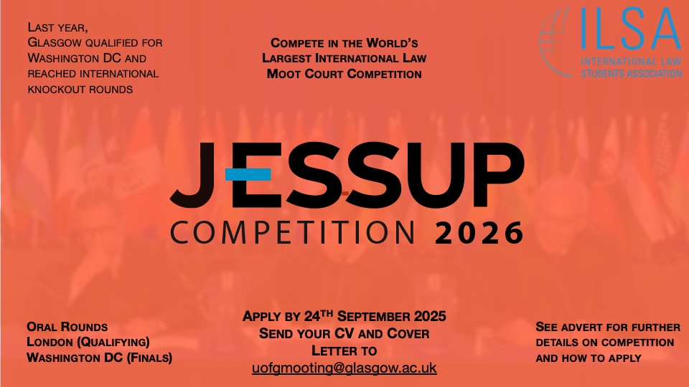

Slide 3
Our Job Today
To introduce you to the main features, and to highlight important details, of the course.
To trace the development of international investment law.
To highlight the key milestones and their continuing significance.
To explore the basic architecture of international investment law.
To consider its main actors.
To lay the groundwork for the weeks to come.
But first, a little housekeeping…

Slide 4
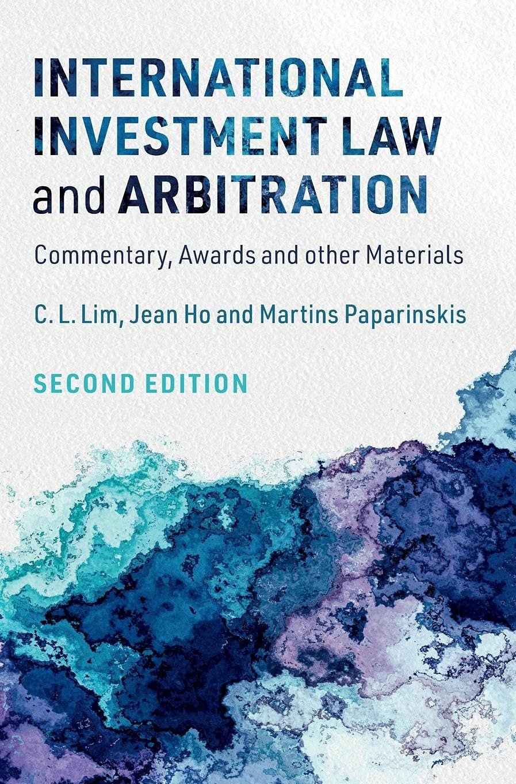
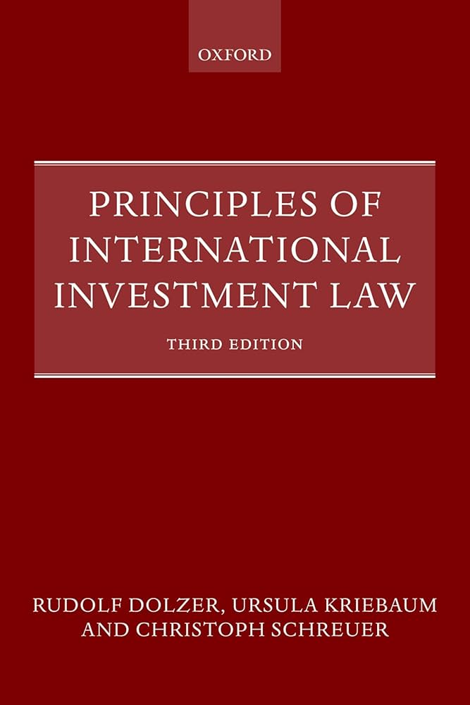
Housekeeping
Course team.
Readings and slides.
Textbooks and statute books.

Slide 5
Assessment
Students will be required to write a 4,000 word essay (research paper) which will be due on 3 December 2025 (4pm) and which will account for 100% of the final mark for the course.
The formative essay, due on 31 October 2025, will be used to scaffold students’ approach to the summative essay.

Slide 6
Timetable
Date | Seminar | Topic
22/9/25 | 1 | Basic Features and Historical Development (Devaney)
23/9/25 | 2 | ‘Investment’ and ‘Investor’ Defined (Tams)
6/10/25 | 3 | Treaty standards (1): Protection against Expropriation (Papadaki/Devaney)
13/10/25 | 4 | Treaty standards (2): Fair and equitable treatment (Devaney)
20/10/25 | 5 | Treaty standards (3): MFN and national treatment (Devaney)
27/10/25 | 6 | Investment Contracts / Defences (Crampin)
31/10/25 | Formative essay due
3/11/25 | Reading Week
10/11/25 | 7 | Investment arbitration & formative essay feedback (Devaney)
17/11/25 | 8 | Challenging and Enforcing Awards (Devaney)
24/11/25 | 9 | The ‘legitimacy crisis’ in international investment law (Devaney)
1/12/25 | 10 | Synthesis: & Special Issues in International Investment Law (Papadaki/Devaney)
3/12/25 | Summative essay due

Slide 7


Slide 8
Group Task
You are a lawyer for BioLife Inc., a French health food company which has recently made a large investment in the Philippines in the form of the construction of a factory to produce coconut oil. In recent months, however, riding a wave of nationalism, the President of the Philippines has pledged to ‘take back control’ of the country’s resources from foreigners, and to that end has unilaterally and without warning revoked a number of safety certificates that BioLife requires under the law of the Philippines in order to operate.
Advise the board of BioLife as to how they might seek to protect their investment using international law.

Slide 9
Foundational Concepts
What is foreign direct investment (FDI)?
Why do investors engage in FDI?
Why do States engage in FDI?
Why is International Investment Law necessary?
Answer lies in the nature of FDI itself
FDI is a form of long-term investment. But what is the significance of this to investors?
Risk: The fact that the investor spends money up front to invest in a country often with a long period before the investor can hope to see any return on this investment represents risk.

Slide 10
International Investment Law - Fundamentals
What do investors gain from International Investment Law?
Investment protection mitigates the risk that investors incur when engaging in FDI.
What do States gain from International Investment Law?
The creation of a legal regime for FDI that is attractive to investors and as such acts as a magnet for FDI.

Slide 11
Means of Protecting Foreign Direct Investments
Use of force (Drago-Porter Convention, 1907)
Domestic law of host state
Diplomatic protection
State-to-State dispute resolution (arbitration and adjudication)
Investor-State arbitration under investment contract
Investor-State arbitration under international investment agreement (bilateral investment treaties)

Slide 12
Historical development of international investment law
Vandevelde (2005) divides historical development of investment law into 3 broad eras:
The colonial era
The post-colonial era
The global era.

Slide 13
1. The Colonial Era: Defining Characteristics
At this time international law did not play a great role in the protection of investments. Why?
Imperial regimes often able to either impose terms on their colonies or apply their law extraterritorially
This gave FDI association with foreign domination
Prior to the WWII, protection of foreign investment not primarily concern of international agreements.
Trade and limited investment protection provisions appeared in the same agreements (FCNs). But emphasis on something else, what?
FCNs more focused on establishing commercial relations than providing investment protection.
FCNs limited in scope and only weak protection provided, with no provision for arbitration.

Slide 14
1. The Colonial Era: Defining Characteristics
Main source of protection of investments prior to WWII?
Customary international law (which obligated states to treat investments in accordance with contested international minimum standard).
Elihu Root’s 1910 address to the American Society of International Law:
“Each country is bound to give to nationals of another country in its territory the benefit of the same laws, the same administration, the same protection, and the same redress for injury which it gives to its own citizen’s, and neither more nor less: provided the protection which the country gives to its own citizens conforms to the established standard of civilization.

Slide 15
1. The Colonial Era: Lack of International Legal Consensus
During colonial era, disagreement over legal principles governing compensation, famously expressed in exchange of letters between US SoS Cordell Hull and Mexican counterpart in aftermath of Mexican (and Russian) revolution. Position of Mexico influenced by Calvo doctrine. What is it?
Calvo Doctrine: Foreign investors afforded only National Protection and disputes settled through domestic courts (essentially removing international law from investment protection disputes, and rejecting diplomatic espousal).
Rationale: foreign investors should not be entitled to any rights or privileges not accorded to nationals.
Requires that aliens commit themselves, by their very contract with the State, not to seek diplomatic protection.
Notes:
Carlos Calvo (1824–1906) was born in Buenos Aires, at a time when Argentina had just achieved independence from Spain. Preservation of its sovereignty was thus one of the main concerns of the new nation, as it continued to be for quite a while, a shown by the Drago Doctrine (1902)
Harry Roberts case – facts?
US Citizen, arrested for murder, detained for 19 months. US brought case against Mexico (under an inter-State arbitration). Leaving aside the murder aspect of the case, in relation to Mr. Roberts’s treatment by the Mexican authorities the Tribunal rejected the National Treatment standard in favour of the “ordinary standards of civilisation” standard.
What is the significance of this? Well, This is a minimum standard, not national treatment, and crucially is not a domestic law standard but an international law standard – taking the power out of the domestic State’s hands.

Slide 16
1. The Colonial Era – International Minimum Standard
Ineffective protection of investments – why?
Some States disputed CIL imposed an international minimum standard, e.g. Latin American States sought to adhere to Calvo doctrine.
Even where international minimum standard agreed, in practice content was vague and arguably quite low.
In absence of agreement by host State to submit any dispute to arbitration, only mechanism offered by customary international law to enforce customary norms was espousal under diplomatic protection.
As such, non-legal means such as military force and diplomatic protection were only means to protect foreign investments.

Slide 17
1. The Colonial Era: Diplomatic Espousal
How does it work?
Home State ‘espouses’ claim of its national against Host State.
Based on legal fiction dating back to Vattel that any injury against a national is to be considered injury against the State of which that individual is also a national.
Operated widely throughout 18th and 19th Centuries,
By 1924 PCIJ in Mavrommatis described it as ‘an elementary principle of international law’.

Slide 18
1. The Colonial Era: Diplomatic Protection
Claim must be brought in accordance with specific conditions regarding, for example, how long a person must live in a State before they can be considered a national and diplomatically protected
Local remedies must first be exhausted
The right to exercise diplomatic protection completely at the discretion of the State. Investor subject to willingness of Home State to bring a claim.
Could be perceived as coercive given power imbalance between States.

Slide 19
1. The Colonial Era: Diplomatic Protection
Further problems?
Enforcement often problematic e.g. ‘gunboat diplomacy.’
UK intervened in Latin America more than 40 times between 1820 and 1914 to enforce British claims for injuries to its nationals and to protect property.
Latin American states pushed back against this practice.
After the UK, Germany and Italy intervened in 1902 in Venezuela, Argentinian Foreign Minister Luis Drago wrote diplomatic note to the US.
Led to the development of Drago Doctrine and the Calvo Doctrine and ultimately to the Hague Convention II of 1907, the Drago-Porter Convention.

Slide 20
1. The Colonial Era: Drago-Porter Convention 1907
Article 1: The Contracting Powers agree not to have recourse to armed force for the recovery of contract debts claimed from the Government of one country by the Government of another country as being due to its nationals. This undertaking is, however, not applicable when the debtor State refuses or neglects to reply to an offer of arbitration, or, after accepting the offer, prevents any compromis from being agreed on, or, after the arbitration, fails to submit to the award. It is further agreed that the arbitration mentioned in paragraph 2 of the foregoing Article shall be subject to the procedure laid down in Part IV, Chapter 3, of The Hague Convention for the Pacific Settlement of International Disputes. The award shall determine, except where otherwise agreed between the parties, the validity of the claim, the amount of the debt, and the time and mode of payment.

Slide 21
1.Moving on from colonialism: The ‘Great Compact’
Taken together, this created what Reisman has called the Great Compact:
investors’ States would waive the deployment of their superior power to protect their investors in return for host States’ agreeing to submit the disputes with those investors to international arbitration by independent third party determination.

Slide 22
1. The Colonial Era: Recap
During colonial era, Imperial states could often impose terms or apply their own domestic law.
And even in those cases where imperial states could not do so, there was no network of international investment protection through treaties. Treaties at this time like FCNS had only modest (if any) provisions on investment and were mainly intended to encourage international trade
As such, customary international law was the source of protection of investments. The generally accepted standard was that of the international minimum standard – although this was not effective in protecting investments for a number of reasons, including the fact that it was not accepted by all States, and that there were no means to enforce this standard apart from military force (which was not outlawed until the Drago-Porter Convention of 1908) or through diplomatic protection.
Diplomatic Protection was where States could take up the cause of their nationals and espouse it to the other State. Although conditions were imposed on diplomatic protection it was nevertheless open to abuse.
This Abuse led to growing support for the so-called Calvo doctrine and the debate between the international minimum standard and the Calvo doctrine continues in one form or another to this day in international investment law.

Slide 23
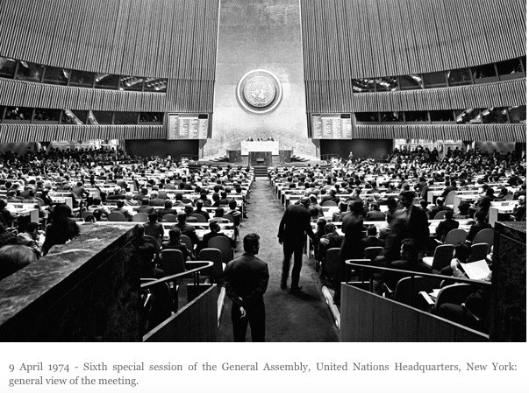
2.The Post-Colonial Era

Slide 24
2. Post-Colonial Era
Decolonisation brought wave of expropriations and corresponding requests for investment protection and compensation. Why?
Newly independent States nationalised and expropriated various investments made by European companies.
NIS often found their natural resources still controlled by foreign companies which they believed blocked their access to means to grow and develop.
As well as the principle of self-determination, the principle of permanent sovereignty over natural resources was developed.

Slide 25
2. Post-Colonial Era
Focal point of the NIEO?
Sought to use UNGA to achieve fair allocation of the world’s resources, technology transfer to developing counties and preferential trade conditions.
Challenged the ‘Great Compact’ by excluding application of international law by a tribunal independent of the State.
Passed UNGA Res such as Declaration on the Establishment of a New International Economic Order (NIEO) (A/RES/S-6/3201 (1974) and Charter of Economic Rights and Duties of States (CERDS) (A/RES/40/182 (1985).
The NIEO also attacked the so-called ‘Dependency Theory’ which held that FDI left developing countries dependent on foreign corporations and subject to their will.

Slide 26
2. Post-Colonial Era
Demise of the NIEO:
By end of 1970s, dominance of neo-liberal thinking and policies.
Legal insecurity regarding the status of foreign investment under NIEO principles led to the slowing of private investment flows to developing countries in the 1970s.
1990s brought remarkable growth of the world economy, including that of many developing countries, notwithstanding recurring financial crises and inflation alarms. Market forces dominant in trade, investment, and finance.

Slide 27
2. Post-Colonial Era
Western States in UN Charter era unable to resort to gunboat diplomacy to protect investments (although, see UK/French involvement in Suez fiasco).
US led multilateral efforts, e.g. pushing inclusion of a multilateral investment code within the remit of the International Trade Organization (Havana Charter). Mooted but abandoned.
Further proposal for multilateral treaty suggested by major capital-exporting states in 1959:

Slide 28
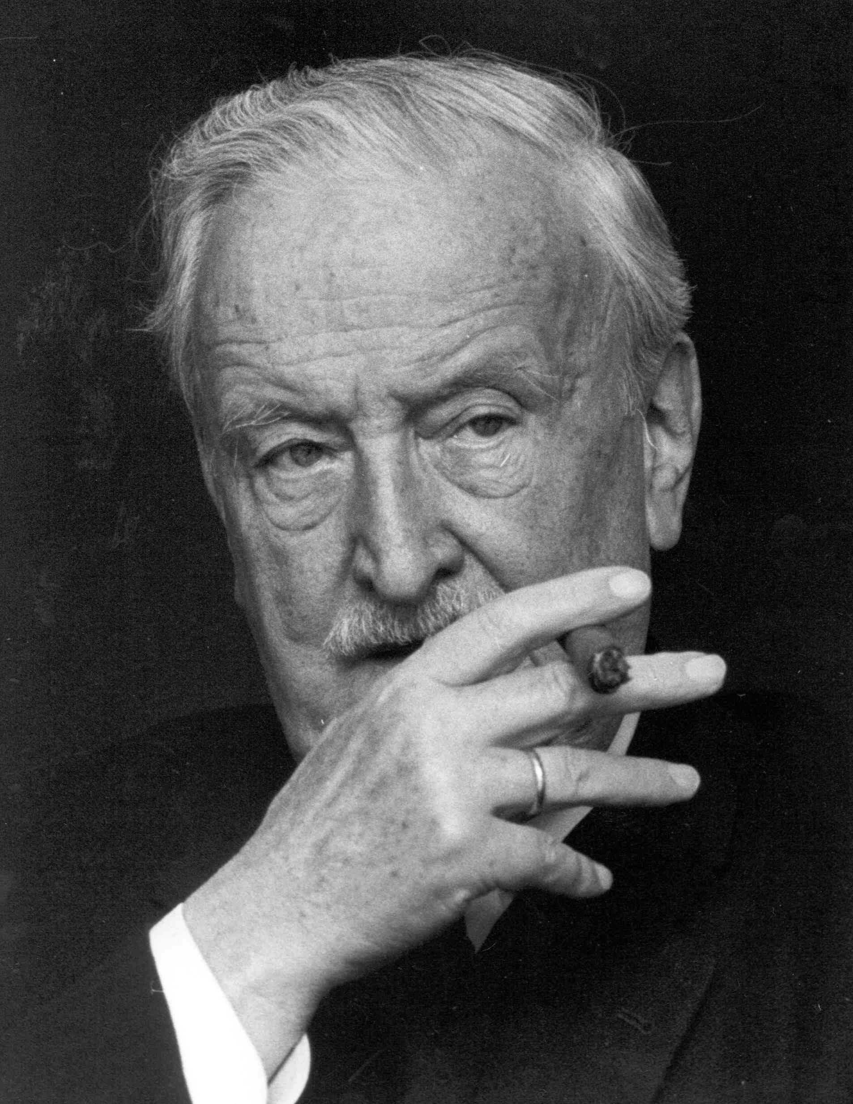
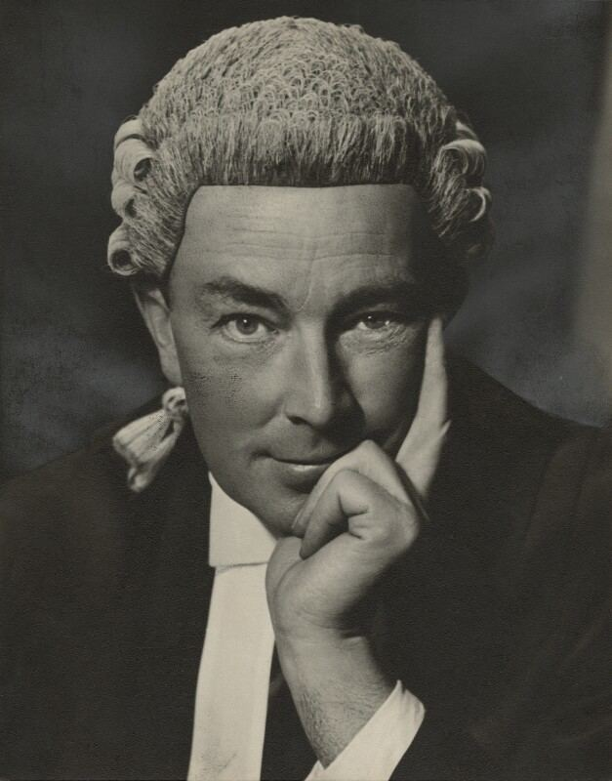
2. Post-Colonial Era
Hermann Abs, Chairman Deutsche Bank
Lord Hartley Shawcross

Slide 29
2. Post-Colonial Era
Merged joint proposals to create Association for Promotion and Protection of Private Foreign Investment in Geneva.
In 1958 published draft Abs-Shawcross Convention, which included investor-State arbitration option.
Played major role in in shaping subsequent OECD Convention, which was essentially a revised version of this text.
Yet even this watered down version failed to gain support.
World Bank was asked to pursue issue at multilateral level. Leading, in 1965 to…

Slide 30
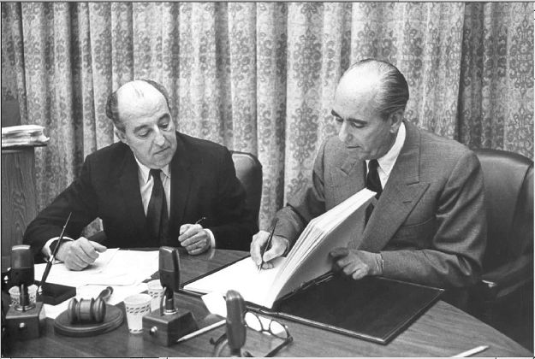
2. Post-Colonial Era
Image: Bank President George Woods (r) signs the ICSID Convention, with Aron Broches (l), General Counsel of the World Bank. Courtesy of World Bank Group Archives

Slide 31
3. The Global Era
The Establishment of ICSID
Inclusion of investor-State arbitration provisions had been prompted by the conclusion of a 1965 convention establishing the International Centre for the Settlement of Investment Disputes (ICSID),".
Why was ICSID created?
This body, affiliated with the World Bank, intended to provide a venue for arbitration of disputes between investors and host state governments.
Taking up its mandate enthusiastically, in 1969 ICSID published a series of model BIT arbitration clauses for use in BITs.
And subsequently Chad-Italy (1969) was first BIT that provided for investor-state arbitration with unqualified state consent.

Slide 32
3. The Global Era
Led to establishment of ‘Great Compact 2.0’ according to Reisman, with addition of:
Investor initiative to bring claim, designed to ’de-politicise’ investment disputes.
But developed States did not seriously imagine that they would be subject to claims through ICISD.
Have their chickens come home to roost, as Reisman suggests?
What future for the Great Compact?

Slide 33
3. The Global Era
Early BIT era:
The first is Germany-Pakistan BIT in 1959. Other European nations soon followed such as France in 1960, Switzerland in 1961 and the Netherlands in 1963.
Spate of expropriations in the 1970s convinced more States to conclude BITs such as the UK in 1975 Japan in 1977.
US decided to start its BIT programme in this year too although did not actually conclude its first BIT until 1980.

Slide 34
3. The Global Era
Early BIT era – characteristics?
Dealt exclusively with investment
Negotiated principally between one developed and one developing country
Motivation for developing country: attract FDI
Motivation for developed country: protect foreign investments
Network of BITs remained limited
Protections provided in early BITs broadly similar to those set out in FCNs

Slide 35
3. The Global Era
‘Global Era’: defining developments?
Development of investor-State arbitration
Influence of ICSID
Explosion in number of BITs
Development of IIAs (intermingling of trade and investment provisions)
Blurring of the distinction between developed and developing countries
Huge increase in investor-State arbitration

Slide 36
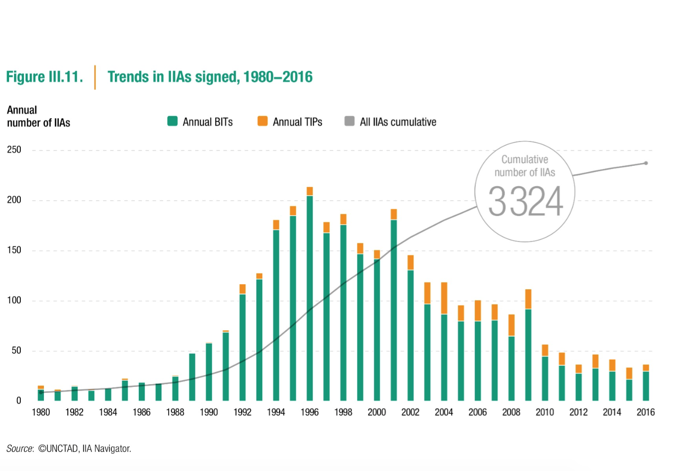
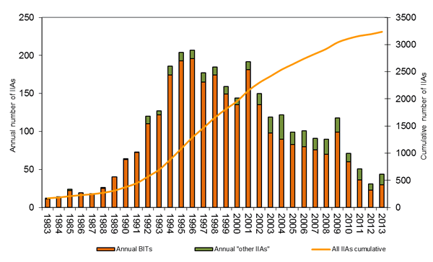
3. The Global Era: ISDS

Slide 37
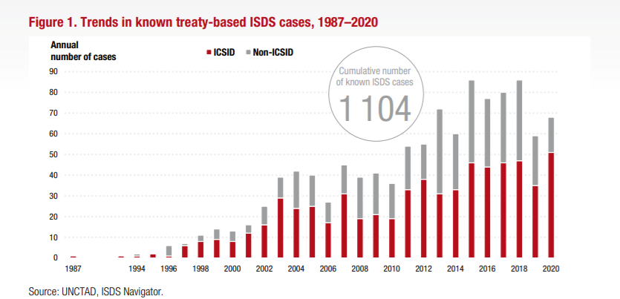
3. The Global Era: ISDS

Slide 38
3. The Global Era – A Multilateral Investment Treaty?
Abs–Shawcross did not result in a multilateral treaty, - opposed by capital-importing states.
But 1967 Draft OECD Convention based on it, and this was model for early European bilateral treaties.
In 1980s, proposal for a multilateral investment treaty at the Uruguay Round of GATT also failed.
Recent EU Proposals for Multilateral Investment Court.
Significance of this story of failure?

Slide 39
Food for Thought
Even without a multilateral code, have capital-exporting states have managed to achieve, through networks of bilateral and regional treaties, the high level of protection for foreign investors that they long sought on behalf of international business?

